Slide 1

Hackathon #3 - Time Series Forecasting
September 27th, 2020

Slide 2
Covid Haters
Andrés Mangas
Fernanda Cohen
Sonia Seyedallaei

Slide 3
1. Problem description

Slide 4
Problem description
Warning! Fake news about covit are around and we are going to catch them in this hackthon. For this we are checking the title of some news and identify what are fake

Slide 5
2. Workflow

Slide 6
2.1 Data preparation

Slide 7
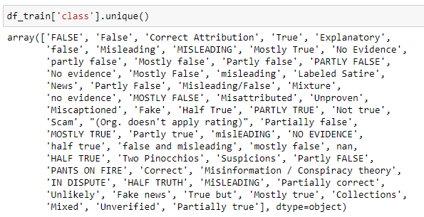
EDA (exploratory data analysis)
Labeled dataset has 60 different values of the target
Remove NaN
Analyse special car

Slide 8
Handling data problems
Imbalanced dataset
176 – true
Revome some observations

Slide 9
2.2 Model selection

Slide 10
Model selection
We’ve started using MultinomialNB but had f1_score = 0.
Change to Random Florest
Baseline
10% true labels
f1_score = 0,17
2º submission
50% true labels
f1_score validation = 0,80
f1_score = 0,18
10% true changing the classifier – f1_score = 0,22
Over and Under sample – f1_score = 0,10
overfitting

Slide 11
2.3 Results and discussion

Slide 12
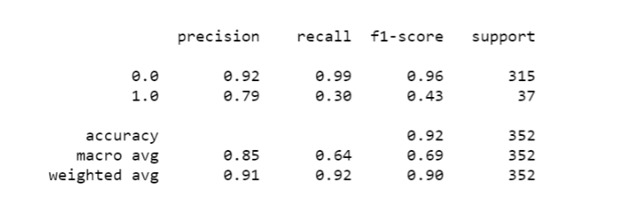
Results and discussion
f1_score = 0,37
dataset with 10% of true labels
Title
Some extra features

Slide 13
3. Future Work

Slide 14
Future work
Use complete dataset
Explore more features:
Use one hot enconding in article_source
Features selection using PCA and SVC
Spacy
Hyperparameters tunning

Slide 15
The End!

Slide 16
Pun!

